Slide 1
Reverse Address Resolution Protocol (RARP)
Reverse Address Resolution Protocol (RARP) is a network protocol used to map a hardware address (MAC address) to an IP address. This is essentially the reverse of what Address Resolution Protocol (ARP) does. While ARP maps an IP address to a MAC address, RARP does the opposite.
Key Features of RARP : Purpose:
Mapping Hardware to IP: RARP allows a device that knows its MAC address but does not know its IP address to discover its IP address from a RARP server.
Typical Use Case:
Diskless Workstations: RARP was traditionally used by diskless workstations or devices that boot from a network and need to obtain an IP address to start network communication.
How RARP Works : RARP Request:
Initiation: A device sends out a RARP Request packet over the network. This request includes the device’s MAC address and asks for the corresponding IP address.
Broadcast: The RARP Request is broadcast to all devices on the local network.
RARP Reply: Response: A RARP server on the network receives the request and looks up the MAC address in its RARP table to find the corresponding IP address.
Unicast: The RARP server sends a RARP Reply back to the requesting device with the IP address.
Configuration:
Update: The device receives the RARP Reply and configures itself with the obtained IP address, allowing it to participate in network communication.

Slide 2
Reverse Address Resolution Protocol (RARP)
RARP Packet Structure
Hardware Type: Type of hardware for which the request is made (e.g., Ethernet).
Protocol Type: Type of protocol (e.g., IPv4).
Hardware Address Length: Length of the hardware address (e.g., 6 for MAC addresses).
Protocol Address Length: Length of the protocol address (e.g., 4 for IPv4 addresses).
Operation: Specifies if the packet is a request or reply.
Sender Hardware Address: MAC address of the device sending the request.
Sender Protocol Address: The IP address field is zeroed out in a request but filled in a reply.
Target Hardware Address: The MAC address being queried (e.g., the MAC address of the requesting device).
Target Protocol Address: The IP address that is to be resolved.
RARP vs. ARP
ARP: Maps an IP address to a MAC address.
RARP: Maps a MAC address to an IP address.

Slide 3
Reverse Address Resolution Protocol (RARP)
Limitations of RARP
Limited Use: RARP has largely been replaced by the more versatile Dynamic Host Configuration Protocol (DHCP), which not only assigns IP addresses but also provides additional configuration information like DNS servers, gateway addresses, etc.
Static Configuration: RARP requires a static table of MAC-to-IP mappings on the RARP server, which can be cumbersome to manage compared to DHCP's dynamic allocation.
Scalability: RARP is less flexible and scalable compared to DHCP, which can handle a broader range of network configuration tasks.
Modern Alternatives
DHCP (Dynamic Host Configuration Protocol):
Functionality: Provides dynamic IP address assignment, as well as additional network configuration details.
Advantage: DHCP can manage a large number of devices efficiently and provides a richer set of configuration options compared to RARP.
BootP (Bootstrap Protocol):
Functionality: Like RARP, BootP was used for network-based booting but also provided additional configuration information.
Transition: DHCP is often used as a replacement for both RARP and BootP due to its greater functionality and flexibility.

Slide 4
Reverse Address Resolution Protocol (RARP)
Example Scenario
Device Initialization:
A diskless workstation with MAC address 00:1A:2B:3C:4D:5E starts up and does not have an IP address.
RARP Request:
The workstation sends a RARP Request broadcast on the network, asking for the IP address associated with its MAC address 00:1A:2B:3C:4D:5E.
RARP Reply:
The RARP server receives the request, looks up the MAC address in its table, and responds with an IP address (e.g., 192.168.1.10).
IP Configuration:
The workstation receives the reply, configures itself with the IP address 192.168.1.10, and proceeds to operate on the network.

Slide 5
Dynamic Host Configuration Protocol DHCP
DHCP stands for Dynamic Host Configuration Protocol. It’s a network protocol used to automatically assign IP addresses and other network configuration details to devices on a network. This helps devices communicate with each other and access network resources without needing manual configuration.
Here’s a brief overview of how DHCP works:
DHCP Discover: When a device (client) connects to a network, it sends out a broadcast message called a DHCP Discover packet to find available DHCP servers.
DHCP Offer: DHCP servers on the network respond with a DHCP Offer message, which includes an IP address and other configuration details that the server is willing to assign to the client.
DHCP Request: The client responds to the DHCP Offer with a DHCP Request message, indicating that it has accepted the offer.
DHCP Acknowledgment: The DHCP server confirms the assignment with a DHCP Acknowledgment message, and the client can now use the provided IP address and configuration details.

Slide 6
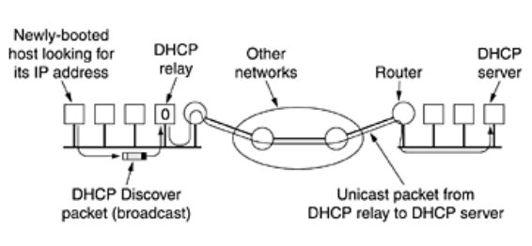
Dynamic Host Configuration Protocol DHCP

Slide 7
Dynamic Host Configuration Protocol DHCP
Benefits of DHCP:
Automated Configuration: Eliminates the need for manual IP address assignment, reducing the risk of errors.
Centralized Management: Simplifies network management by allowing IP address assignments to be managed from a central server.
Efficient Use of IP Addresses: Recycles IP addresses by assigning them on a lease basis, which optimizes the use of available IP address space.
Typical DHCP Configuration Includes:
IP Address: The unique identifier assigned to each device on the network.
Subnet Mask: Defines the network segment the IP address belongs to.
Default Gateway: The router IP address used to access other networks.
DNS Servers: Addresses of servers used to resolve domain names to IP addresses.

Slide 8
Bootstrap Protocol-BOOTP
BOOTP (Bootstrap Protocol) is an older network protocol used to automatically assign IP addresses and other network configuration details to devices on a network. It was designed to help devices find their IP address, gateway, and other essential information when they first connect to the network. BOOTP is often considered a precursor to DHCP (Dynamic Host Configuration Protocol).
How BOOTP Works:
BOOTP Request: When a device (client) needs network configuration, it sends out a BOOTP Request message (broadcast) to discover BOOTP servers.
BOOTP Reply: BOOTP servers respond with a BOOTP Reply message, which includes the IP address and other configuration details that the server assigns to the client.
Configuration: The client receives the configuration details and uses them to communicate on the network.
Key Features of BOOTP:
Static Configuration: Unlike DHCP, which can dynamically assign IP addresses from a pool, BOOTP typically uses static mappings configured on the BOOTP server. Each client has a fixed IP address assigned based on its MAC address.

Slide 9
Bootstrap Protocol-BOOTP
Simple Protocol: BOOTP provides basic functionality for IP address assignment and configuration, but it lacks some of the advanced features of DHCP.
Used in Early Networking: BOOTP was widely used before DHCP became the standard. It is still supported in many networks for compatibility reasons.
Differences Between BOOTP and DHCP:
Dynamic vs. Static Assignment: DHCP allows for dynamic allocation of IP addresses from a pool, whereas BOOTP usually relies on static mappings.
Additional Configuration Options: DHCP provides more configuration options (e.g., lease times, multiple DNS servers) compared to BOOTP.
Address Leasing: DHCP can lease IP addresses for a specific period, allowing for better management of IP address allocation. BOOTP does not support lease times.
Enhanced Features: DHCP includes additional features like automatic renewal of IP addresses and more flexible configuration options, making it more suitable for modern networks.
Use Cases for BOOTP:
Legacy Systems: BOOTP is sometimes used in environments where older systems or devices that only support BOOTP are present.
Simple Environments: For basic, static configurations, BOOTP can still be used, but it is generally replaced by DHCP in most modern networks.

Slide 10
Bootstrap Protocol-BOOTP
Simple Protocol: BOOTP provides basic functionality for IP address assignment and configuration, but it lacks some of the advanced features of DHCP.
Used in Early Networking: BOOTP was widely used before DHCP became the standard. It is still supported in many networks for compatibility reasons.
Differences Between BOOTP and DHCP:
Dynamic vs. Static Assignment: DHCP allows for dynamic allocation of IP addresses from a pool, whereas BOOTP usually relies on static mappings.
Additional Configuration Options: DHCP provides more configuration options (e.g., lease times, multiple DNS servers) compared to BOOTP.
Address Leasing: DHCP can lease IP addresses for a specific period, allowing for better management of IP address allocation. BOOTP does not support lease times.
Enhanced Features: DHCP includes additional features like automatic renewal of IP addresses and more flexible configuration options, making it more suitable for modern networks.
Use Cases for BOOTP:
Legacy Systems: BOOTP is sometimes used in environments where older systems or devices that only support BOOTP are present.
Simple Environments: For basic, static configurations, BOOTP can still be used, but it is generally replaced by DHCP in most modern networks.

Slide 11
Open Shortest Path First-OSPF
OSPF (Open Shortest Path First) is a widely used routing protocol in IP networks. It is designed to find the best path for data to travel through a network by using a link-state routing algorithm.
OSPF is an interior gateway protocol (IGP) used within a single autonomous system (AS), which is a network or collection of networks under the same administrative control.
Key Features of OSPF:
Link-State Algorithm: OSPF uses a link-state routing algorithm to determine the shortest path for data to travel. Each router in the network builds a map of the network's topology by sharing information about its links with other routers.
LSA (Link-State Advertisement): Routers use LSAs to share information about their own links and their states. This information is used to construct a complete network topology, which is then used to calculate the shortest paths.
Dijkstra's Algorithm: OSPF uses Dijkstra’s Shortest Path First (SPF) algorithm to compute the shortest path tree based on the network topology.

Slide 12
Open Shortest Path First-OSPF
Hierarchical Design: OSPF supports hierarchical network design with areas. An OSPF network is divided into areas to improve scalability and manageability.
Area 0 (the backbone area) is the core of the OSPF network, and other areas are connected to it.
Cost Metric: OSPF uses a cost metric based on the bandwidth of the links to determine the shortest path. The lower the cost, the preferred the path.
Routing Tables: Each OSPF router maintains a routing table that is updated based on the SPF calculations. This table contains information on how to reach various network destinations.
Convergence: OSPF provides rapid convergence, meaning it quickly recalculates routes when there are changes in the network topology, such as a router or link going down.

Slide 13
Open Shortest Path First-OSPF
OSPF Operation:
Neighbor Discovery: Routers discover and establish neighbor relationships with other OSPF routers on directly connected networks.
Database Synchronization: Routers exchange LSAs to synchronize their link-state databases, ensuring they have the same view of the network topology.
Topology Calculation: Using the SPF algorithm, routers calculate the best paths through the network and update their routing tables accordingly.
Route Advertisement: Routers advertise their routing information to their neighbors, ensuring that all routers have a consistent view of the network.
A routing algorithm within an AS is called an interior gateway protocol; an algorithm for routing between ASes is called an exterior gateway protocol.

Slide 14
Open Shortest Path First-OSPF
OSPF Types and Areas:
Backbone Area (Area 0): The central area of an OSPF network that all other areas connect to. It is essential for the OSPF hierarchy.
Stub Area: An area that does not receive external routes, simplifying its routing table.
Totally Stubby Area: Similar to a stub area but also prevents the advertisement of inter-area routes, further simplifying the routing table.
Not-so-stubby Area (NSSA): An area that can import external routes but does not advertise those routes outside the NSSA.
Internal Routers: Routers that are entirely within a single OSPF area.
Area Border Routers (ABRs): Routers that connect multiple OSPF areas and handle the routing information exchange between them.
Autonomous System Boundary Routers (ASBRs): Routers that connect an OSPF network to external networks, such as those running different routing protocols.

Slide 15
Open Shortest Path First-OSPF
OSPF supports three kinds of connections and networks:
Point-to-point lines between exactly two routers.
Multi-access networks with broadcasting (e.g., most LANs).
Multi-access networks without broadcasting (e.g., most packet-switched WANs).
All LANs and WANs have this property. An AS containing all three kinds of networks. Note that hosts do not generally play a role in OSPF.
OSPF operates by abstracting the collection of actual networks, routers, and lines into a directed graph in which each arc is assigned a cost (distance, delay, etc.). It then computes the shortest path based on the weights on the arcs. A serial connection between two routers is represented by a pair of arcs, one in each direction. Their weights may be different.
A multi-access network is represented by a node for the network itself plus a node for each router. The arcs from the network node to the routers have weight 0 and are omitted from the graph. A multi-access network is one that can have multiple routers on it, each of which can directly communicate with all the others.

Slide 16
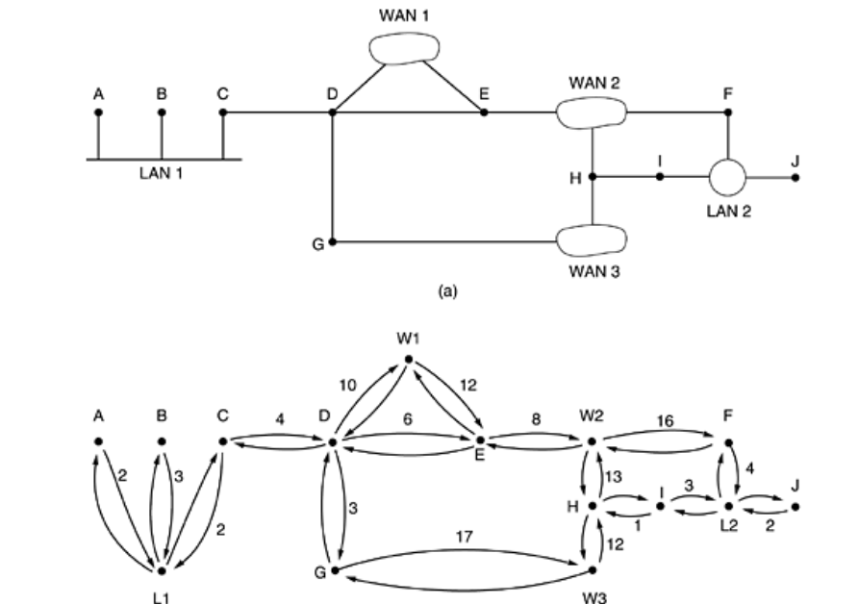
Open Shortest Path First-OSPF

Slide 17
Open Shortest Path First-OSPF
Many of the ASes in the Internet are themselves large and nontrivial to manage. OSPF allows them to be divided into numbered areas, where an area is a network or a set of contiguous networks.
Areas do not overlap but need not be exhaustive, that is, some routers may belong to no area. An area is a generalization of a subnet. Outside an area, its topology and details are not visible.
Every AS has a backbone area, called area 0. All areas are connected to the backbone, possibly by tunnels, so it is possible to go from any area in the AS to any other area in the AS via the backbone.
A tunnel is represented in the graph as an arc and has a cost. Each router that is connected to two or more areas is part of the backbone.
As with other areas, the topology of the backbone is not visible outside the backbone. Within an area, each router has the same link state database and runs the same shortest path algorithm.
Its main job is to calculate the shortest path from itself to every other router in the area, including the router that is connected to the backbone, of which there must be at least one.
A router that connects to two areas needs the databases for both areas and must run the shortest path algorithm for each one separately.

Slide 18
Open Shortest Path First-OSPF
During normal operation, three kinds of routes may be needed: intra-area, interarea, and inter-AS. Intra-area routes are the easiest, since the source router already knows the shortest path to the destination router.
Interarea routing always proceeds in three steps: a. go from the source to the backbone;
b. go across the backbone to the destination area; c. go to the destination.
This algorithm forces a star configuration on OSPF with the backbone being the hub and the other areas being spokes. Packets are routed from source to destination ''as is.''
They are not encapsulated or tunneled, unless going to an area whose only connection to the backbone is a tunnel. Figure shows part of the Internet with ASes and areas.
OSPF distinguishes four classes of routers:
Internal routers are wholly within one area.
Area border routers connect two or more areas.
Backbone routers are on the backbone.
AS boundary routers talk to routers in other ASes.
These classes are allowed to overlap. For example, all the border routers are automatically part of the backbone. In addition, a router that is in the backbone but not part of any other area is also an internal router.

Slide 19
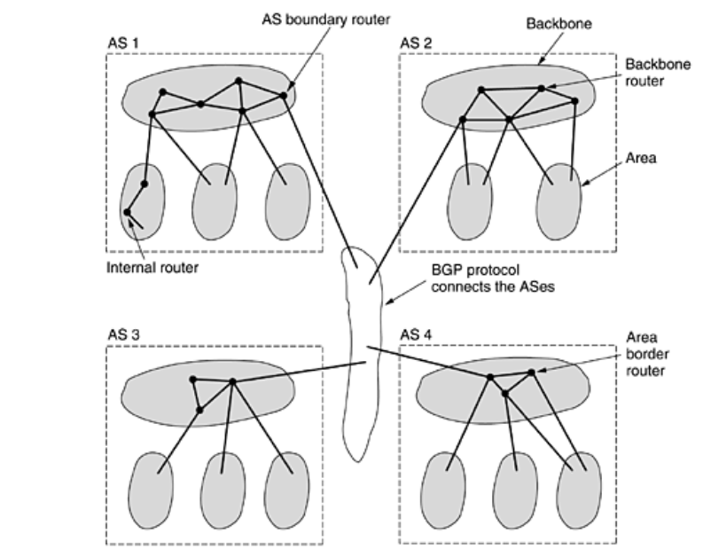
Open Shortest Path First-OSPF

Slide 20
Open Shortest Path First-OSPF
When a router boots, it sends HELLO messages on all of its point-to-point lines and multicasts them on LANs to the group consisting of all the other routers.
On WANs, it needs some configuration information to know whom to contact. From the responses, each router learns who its neighbors are. Routers on the same LAN are all neighbors.
OSPF works by exchanging information between adjacent routers, which is not the same as between neighboring routers.
In particular, it is inefficient to have every router on a LAN talk to every other router on the LAN. To avoid this situation, one router is elected as the designated router. It is said to be adjacent to all the other routers on its LAN, and exchanges information with them.
Neighboring routers that are not adjacent do not exchange information with each other. A backup designated router is always kept up to date to ease the transition should the primary designated router crash and need to replaced immediately.

Slide 21
Open Shortest Path First-OSPF
During normal operation, each router periodically floods LINK STATE UPDATE messages to each of its adjacent routers. This message gives its state and provides the costs used in the topological database. The flooding messages are acknowledged, to make them reliable.
Each message has a sequence number, so a router can see whether an incoming LINK STATE UPDATE is older or newer than what it currently has. Routers also send these messages when a line goes up or down or its cost changes.
Database description messages give the sequence numbers of all the link state entries currently held by the sender. By comparing its own values with those of the sender, the receiver can determine who has the most recent values. These messages are used when a line is brought up.
Either partner can request link state information from the other one by using LINK STATE REQUEST messages. The result of this algorithm is that each pair of adjacent routers checks to see who has the most recent data, and new information is spread throughout the area this way.

Slide 22
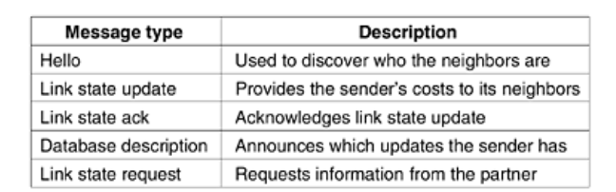
Open Shortest Path First-OSPF
Finally, we can put all the pieces together. Using flooding, each router informs all the other routers in its area of its neighbors and costs. This information allows each router to construct the graph for its area(s) and compute the shortest path. The backbone area does this too.
In addition, the backbone routers accept information from the area border routers in order to compute the best route from each backbone router to every other router.
This information is propagated back to the area border routers, which advertise it within their areas. Using this information, a router about to send an interarea packet can select the best exit router to the backbone.

